Slide 1
EUROPASS CV
By Nafsin Rafiq Naf as a Banking Sector Aspirant

Slide 2
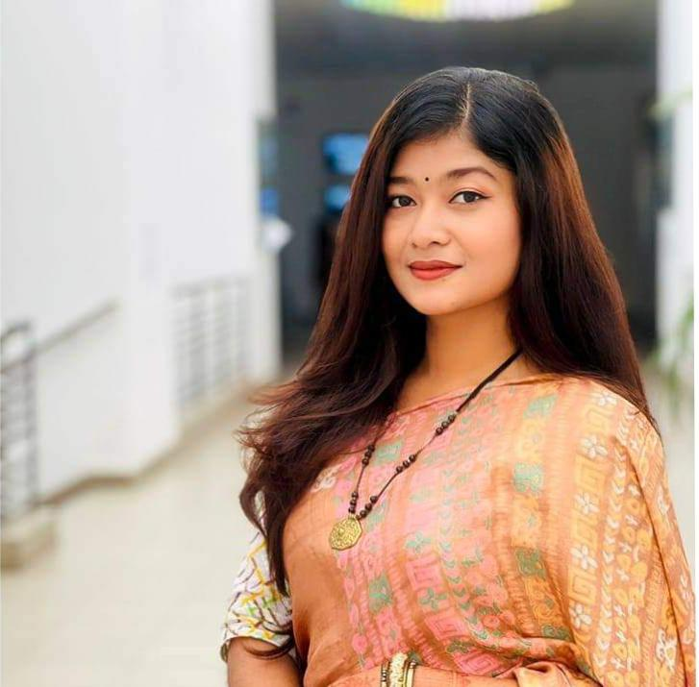
ABOUT ME & CONTACT:
An ambitious and dedicated individual eager to explore new horizons and make a positive impact.
EMAIL- nafsin.rafiq2000@gmail.com
Phone no.- 01725364878
Dhaka,Bangladesh.

Slide 3
EDUCATION:
MARCH 2023-TO DATE:
BBA in Human Resource Management at INDEPENDANT UNIVERSITY BANGLADESH, CGPA-3.58/4.00
JANUARY 2018-MAY 2020
HSC- HOLY CROSS COLLEGE
Farmgate
Group- Business Studies
GPA- 5/5

Slide 4
OBJECTIVE:
To secure an entry-level position within the banking sector, leveraging my educational background and passion for finance to build a strong foundation in banking operations. Progressively grow within the organization, gaining valuable experience and honing my skills to ascend to a prominent role as a top-tier banking executive."

Slide 5
EXPERIENCE:(Marketing Intern at INFOTECH (Oct 2021 - Feb 2022)
Provided excellent customer service, resulting in a 15% increase in customer satisfaction.
Managed inventory, tracked stock levels, and ensured product availability.
Promoted and sold electronic products, meeting or exceeding monthly sales targets.
Trained new hires in product knowledge and customer service best practices.

Slide 6
EXPERIENCE:(Student Ambassador at IUB Admissions Office (Apr 2022 - Present)
Represented the university, contributed to increased applications.
Communicated with prospective students, enhanced the visitor experience.
Collaborated with a diverse team of ambassadors to enhance the visitor experience.
Assisted in organizing campus events and contributed to an increase in applications.

Slide 7
SKILLS:
Team Work
Communication
Marketing
Time Management

